Slide 1

The voice of child’s !! Child is Meant to learn not to earn.

Slide 2


AGENDA
Problem statement
Overview
Solution
Wow factor
Modeling

Slide 3
PROBLEM STATEMENT
“Balancing the scales for kids get education and stay healthy while stopping child labor is a big challenge worldwide. It needs a complete approach to break down barriers and make sure every child has a better future .”

Slide 4
PROJECT OVERVIEW
Project Focus: Addressing the issues of child labor, impotence of child education, and healthcare.
Objective: Break the cycle of exploitation and empower children for a better future.
Impact: Creating an environment where every child can learn and grow, breaking the cycle of poverty and exploitation.

Slide 5

END USERS ??
NGOs
Local Communities
Government Agencies
International Organizations
Donors and Funding Organizations
Educational Institutions

Slide 6

OUR SOLUTION
We help kids in need by combining education and health programs.
We support communities, push for better rules, and team up with others to stop child labor.
Our goal is to give children a chance for a better future through easy-to-access learning materials, financial help, and spreading the word about the issues they face.

Slide 7
THE WOW IN YOUR SOLUTION
Chat Boot
Government Board
Access to Quality Education
Holistic Monitoring and Evaluation
Community-Led Awareness Campaigns

Slide 8

MODELLING
Home
About
Child issue
Media
Join us
Contact
Governing Board
Joining Form
Contact Form
About us
Missing
Picture gallery
Team
Child labor
Video Gallery
Child Marge
News room
Child health

Slide 9
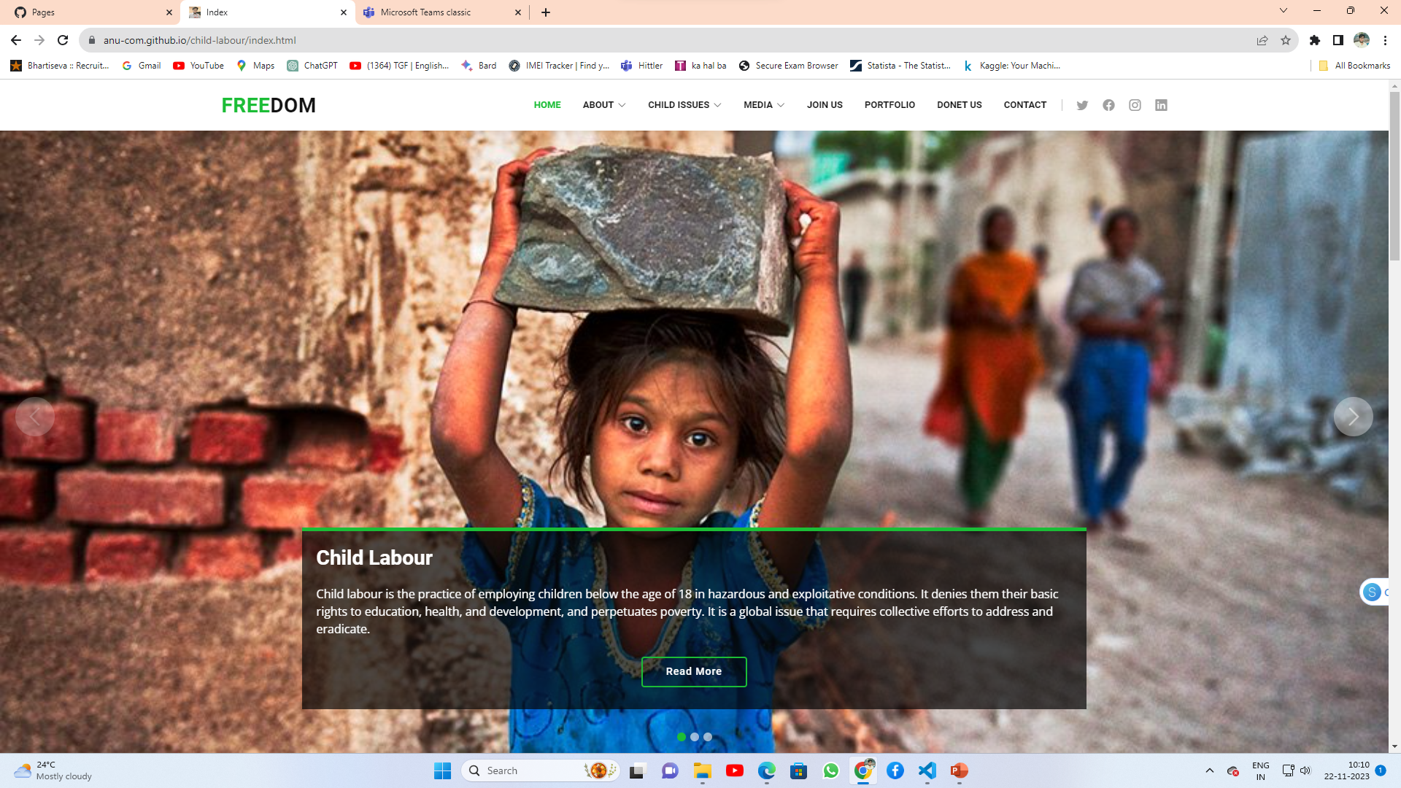
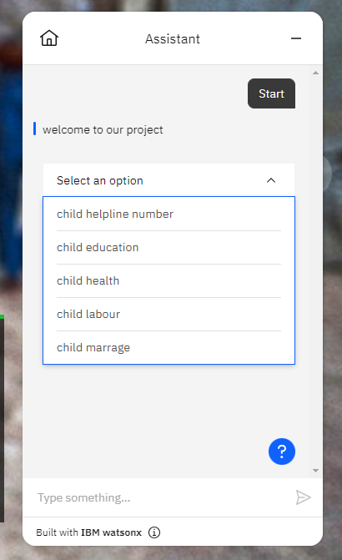
RESULTS
https://cloud-object-storage-cos-static-web-hosting-nid.s3.jp-tok.cloud-object-storage.appdomain.cloud/index.html

Slide 10
MEET OUR TEAM
Aman Hatwar
Anurag Kumar
Md Gaffar
Rajiv Kumar

Slide 11
Thank You all !!

